Slide 1
Code Sample and Github Link

Slide 2
GitHub Link
Here is the github link of the project
https://github.com/ag58884n/CS-691-Project-1-fall-19-
https://github.com/ag58884n/CS-691-Project-1-fall-19-/tree/master/www

Slide 3
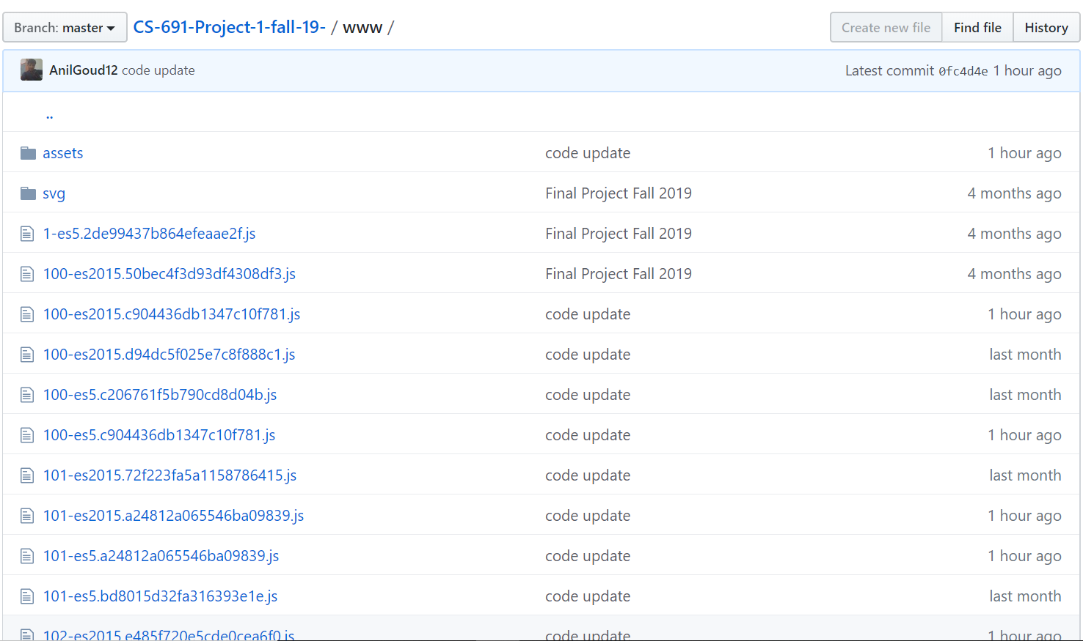
Github code screenshot and code samples

Slide 4
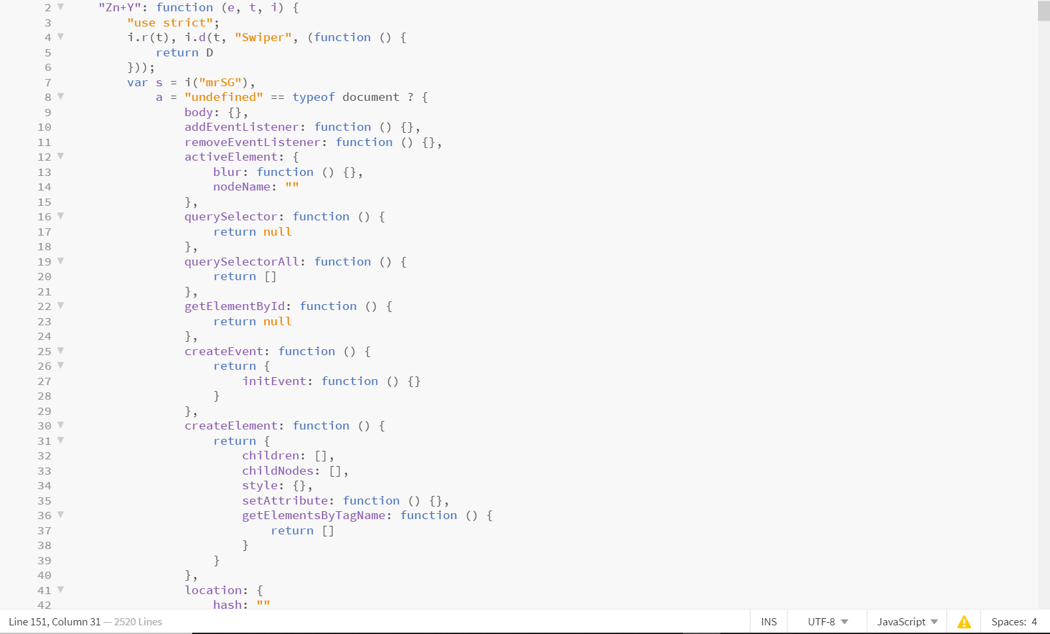

Slide 5
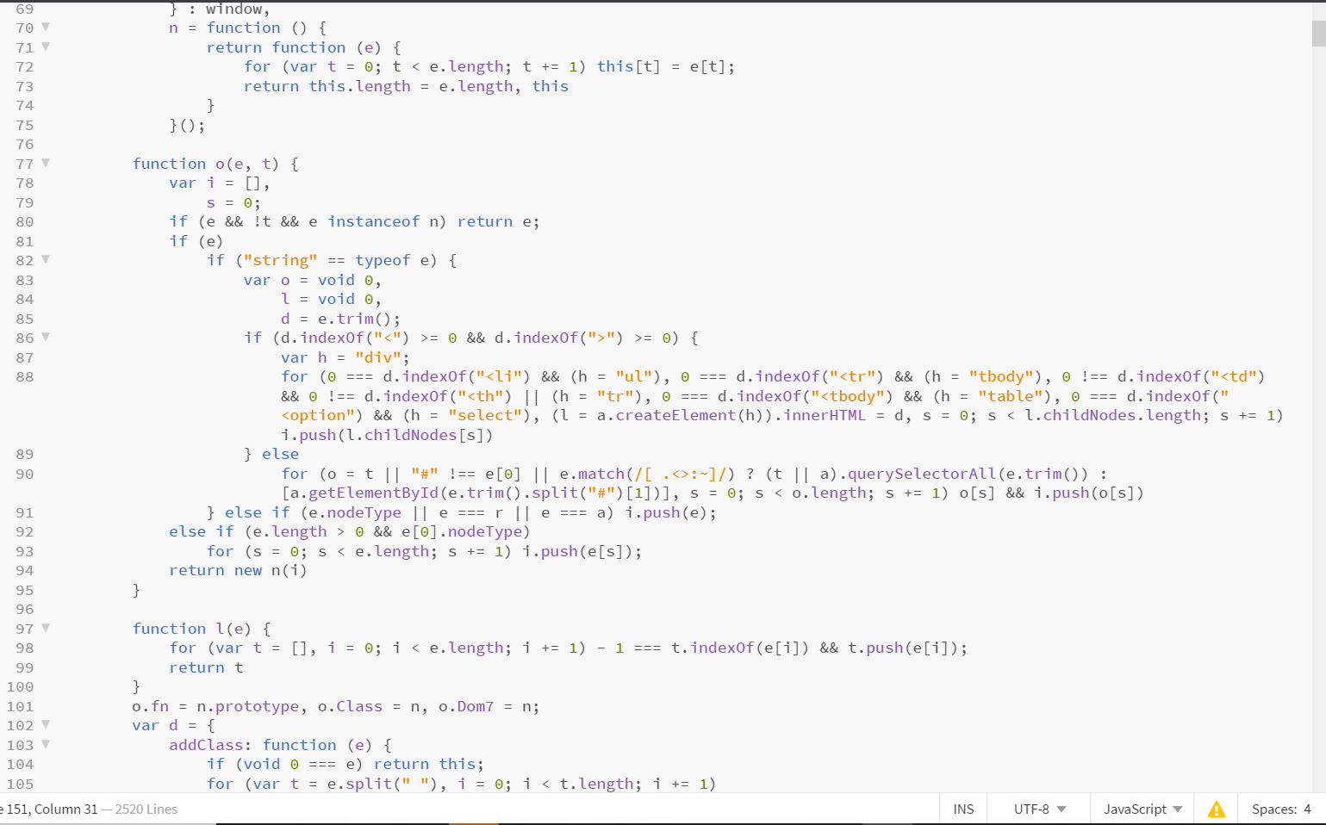

Slide 6
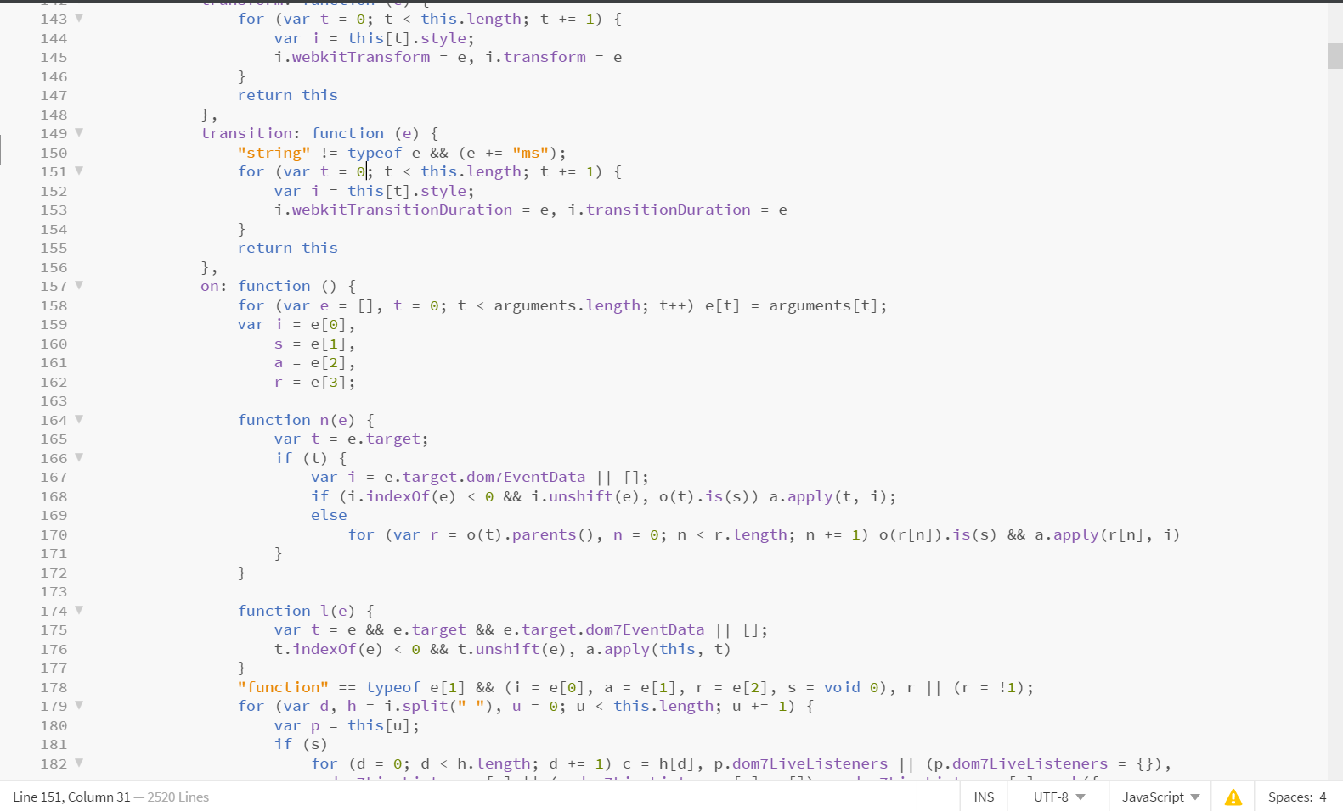

Slide 7
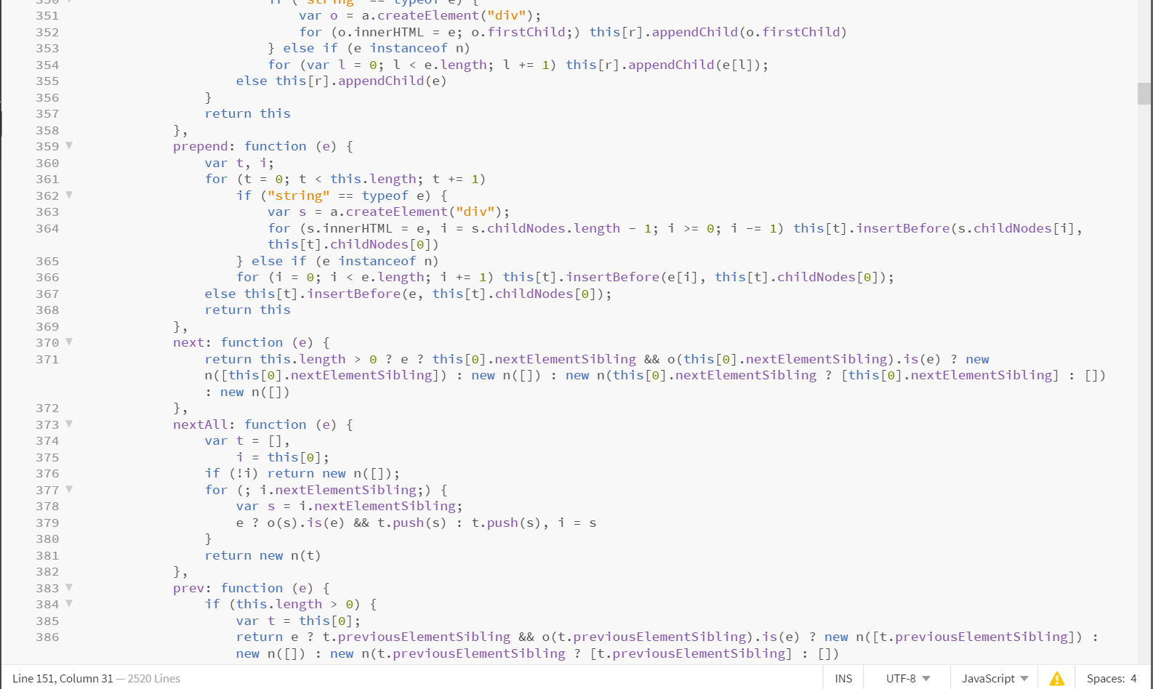

Slide 8
